Slide 1
Data harmonization and insights extraction
BY – PRATEEK AGRAWAL

Slide 2
ABOUT THE PROJECT
In this Project, there are three dataset which contains data that shows on which date, at what temperature –humidity –windspeed how many rides or people went there and at that specific date what is there Weather-situation.
In these datasets, some values are missing and some are in improper way and we have to correct this.

Slide 3
What I did in the project
In this Project, I have received dataset 1, dataset2, dataset 3.
Firstly, I have worked on dataset 1 , pre-processed it with multiple filters, added some visualisations.
Then, Same work I did with dataset 2.
Then, After pre-processing, I have merged dataset 1 and dataset 2 and then applied some new visualisations and find new insights.
After this, I started pre-processing with dataset 3 and added some visualisations.
Then, I have merged dataset 3 with the merged data of dataset1 and dataset2.
Finally, I worked on this data and find outliers in this and handle all these.

Slide 4
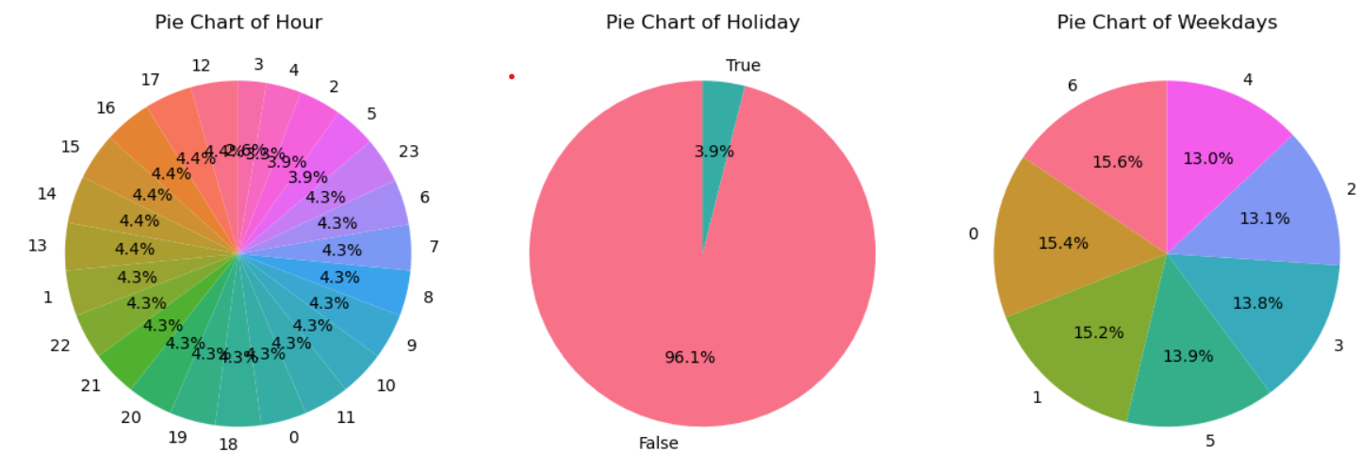
Dataset 01 (pre-processing & visualisations)
I have used multiple functions like .info, .head, .isnull, .unique, .fillna to filter this data.
For Visualisations , I have used Pie Chart & Line Plot.

Slide 5
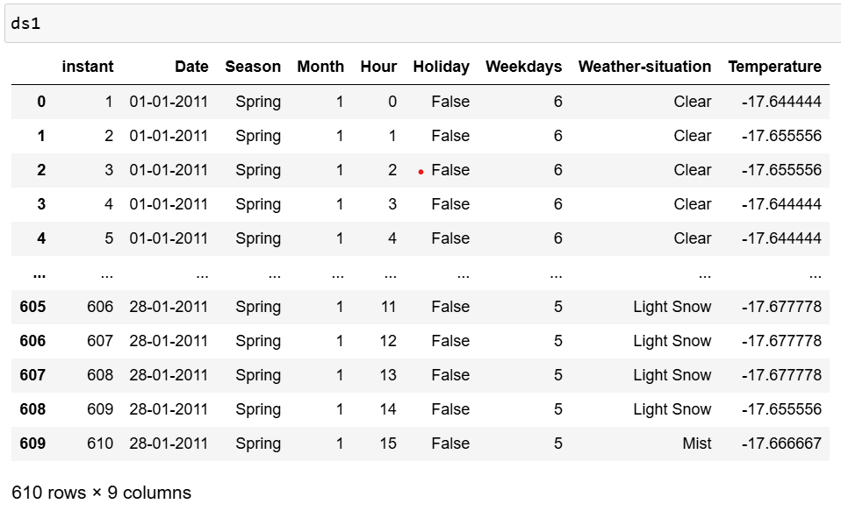
FINAL DATASET 1

Slide 6
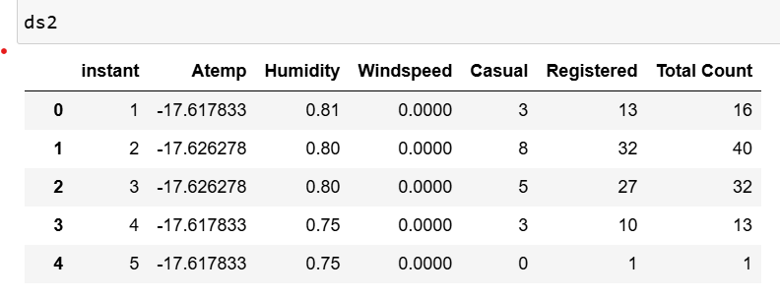
Dataset 02 (pre-processing & visualisations)
I have used multiple functions like .read, .tail, .duplicate, .drop, .apply etc. to filter this data.
For Visualisations , I have used Box Plot & Histogram Plot.

Slide 7
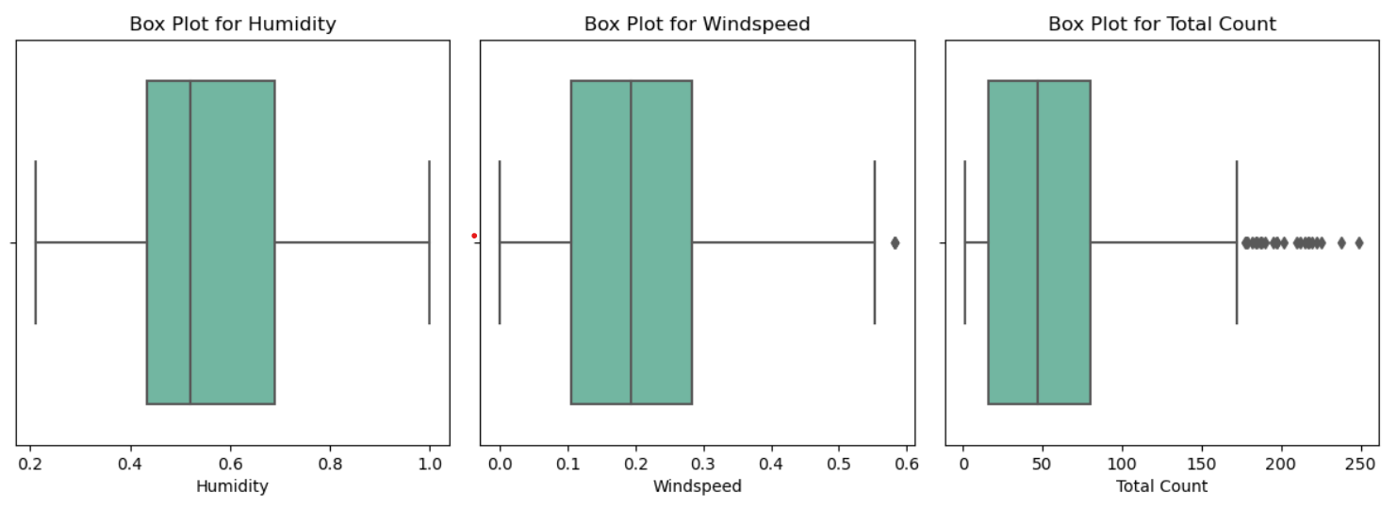
DATASET 2 visualisations

Slide 8
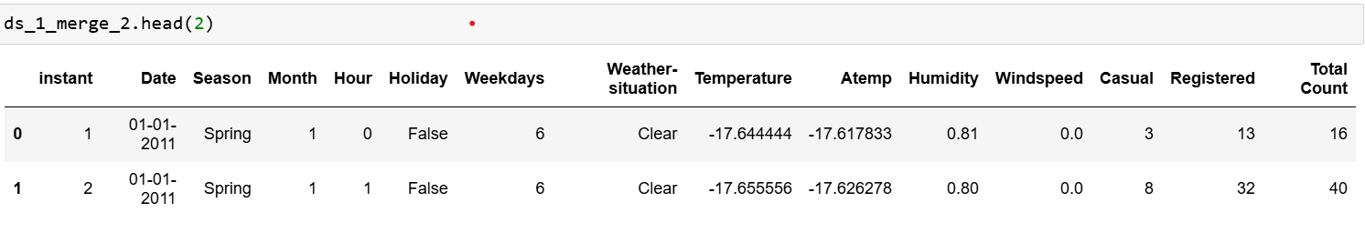
Merge Dataset of 01 & 02 (pre-processing & visualisations)
I have used multiple functions like .read, .head, .duplicate, .isnull etc. to filter this data.
For Visualisations , I have used Line Plot.

Slide 9
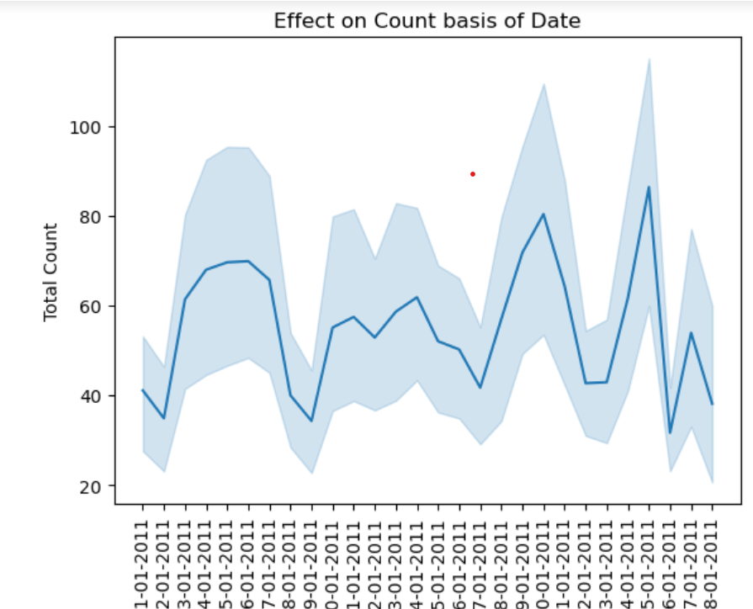
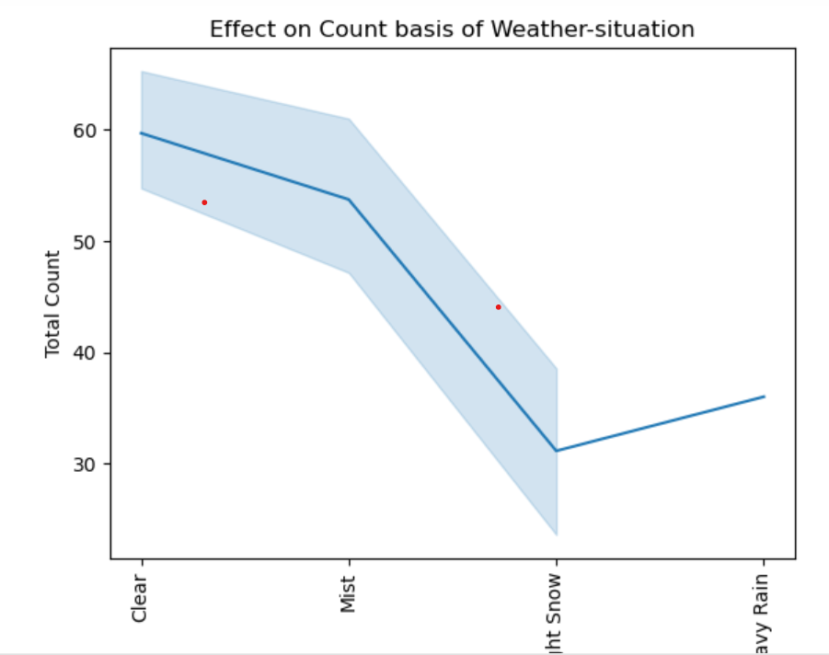
Merge dataset 01 & 02 visualisations

Slide 10
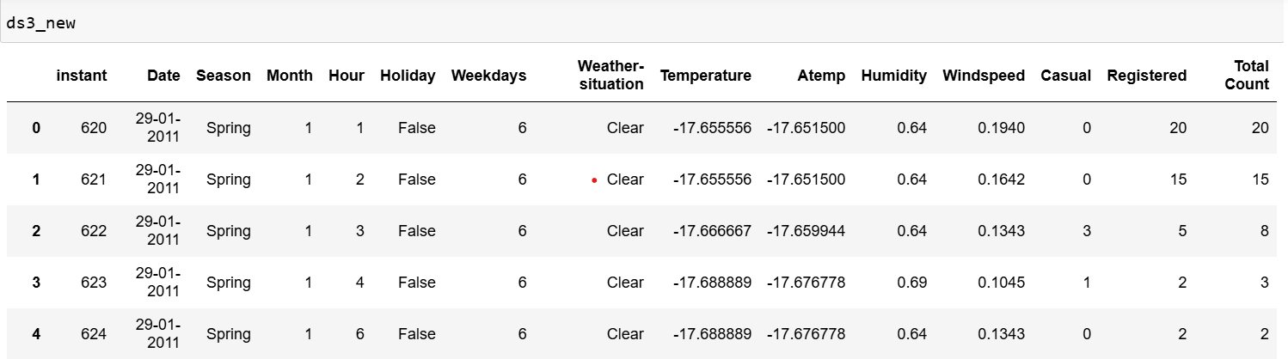
Dataset 03 (pre-processing & visualisations)
I have used multiple functions like .read, .head, .info, .drop, .rename, etc. to filter this data.
For Visualisations , I have used Pie Chart and Scatter Plot.

Slide 11
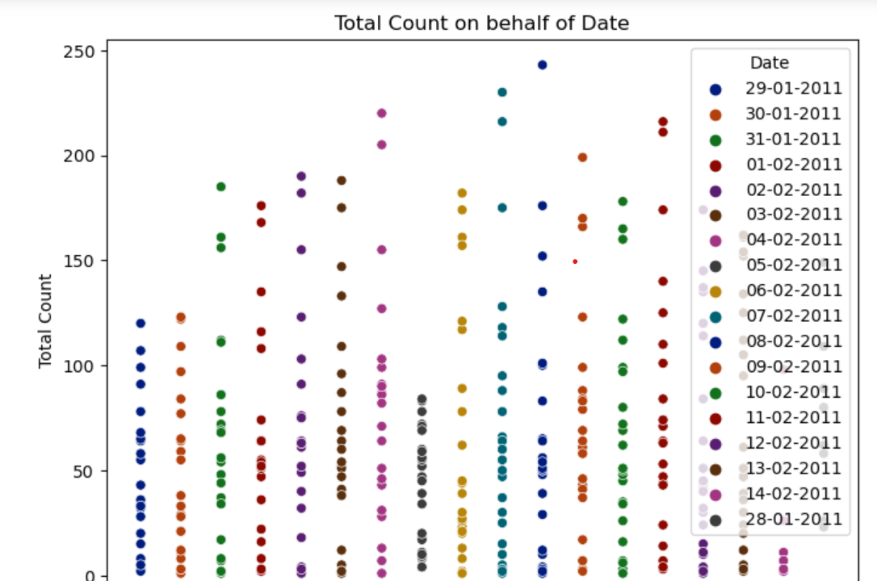
Dataset 03 visualisations

Slide 12
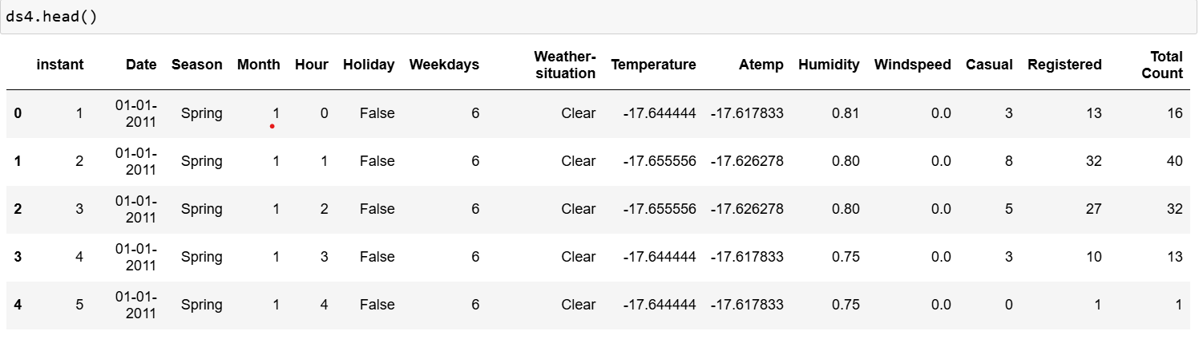
MERGE DATASET 01 & 02 WITH Dataset 03 (pre-processing & visualisations)
I have used multiple functions like .concat, .info, .head, .isnull, .duplicate etc. to filter this data.
For Visualisations , I have used Line Plot, Pie Chart and Histogram Plot.

Slide 13
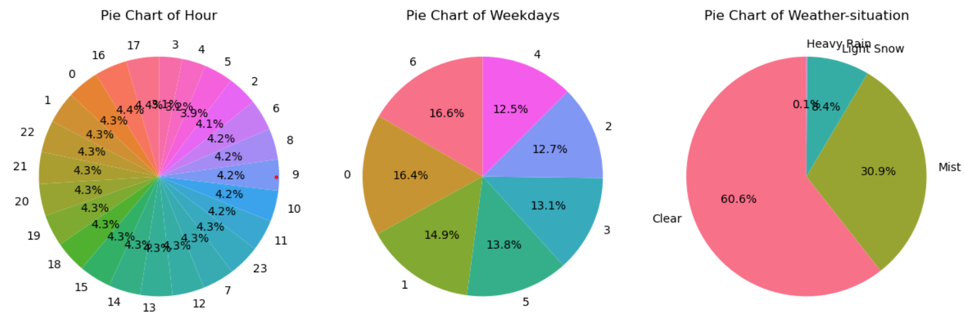
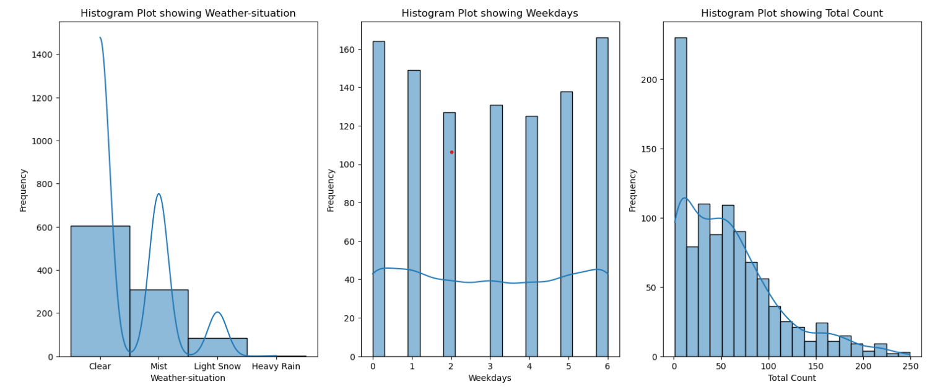
MERGE DATASET 01 & 02 WITH Dataset 03 visualisations

Slide 14
CONCLUSION
Have done with the help of Copilot , Youtube , Digicrome classes, nexthikes and with some other browser.
It is still in progress for better adjustment.

Slide 15
THANKYOU

